Slide 1

Jawahar Education Society’s
A. C. Patil College of Engineering, Kharghar
Department of Artificial Intelligence & Data Science
HOUSE PRICE PREDICTION
Name of Students:
Dipti Patil (57)
Ishwari Mane (52)
Akshata Mishra (53)
Manali Madhavi (48)
Poorva Kharade (43)

Slide 2
INTRODUCTION
House prices vary widely depending on location, household income, age of the house, number of rooms, and the population of the neighbourhood.
Estimating the value of a property manually can be difficult because many factors influence the housing market in an area.
Machine learning can analyze historical housing data and estimate prices based on patterns in the data.
This project develops a house price prediction system using the California Housing dataset (1990 US Census) to predict the median house value of a district in units of $100,000.
Two models, Linear Regression (baseline) and Random Forest Regressor, are trained and compared to find the better predictor of house prices.

Slide 3
MOTIVATION
Home buyers, sellers, and investors need a reasonable estimate of a property's value.
Manual price estimation may be inconsistent and dependent on individual judgment.
Housing prices depend on many interacting factors, such as income, location, and occupancy, which are difficult to weigh by hand.
Understanding which features influence prices the most helps in making informed decisions.
These needs motivate a data-driven system that predicts house prices and identifies the key factors behind them.

Slide 4
OBJECTIVES (General)
To develop a machine-learning-based system for predicting house prices.
To explore and analyze housing data to identify patterns that influence house values.
To preprocess the data by removing duplicates, clipping outliers, engineering features, and scaling.
To train and compare Linear Regression and Random Forest Regressor models.
To evaluate the models on unseen data using MAE, RMSE, and R² score.
To identify the most important features affecting house prices.

Slide 5
PROBLEM STATEMENT
“Estimating the price of a house is challenging because it depends on multiple factors such as income, location, house age, and occupancy. Manual estimation may be inconsistent, so a data-driven machine learning model is needed to predict house prices and identify the factors that influence them.”

Slide 6
PROPOSED SYSTEM
The proposed system is a machine-learning-based house price prediction pipeline built on the California Housing dataset.
Data Collection: The dataset of 20,640 districts with 8 features is loaded using scikit-learn.
Exploratory Analysis: Distributions, correlations, and relationships with the target are examined.
Preprocessing: Duplicates are removed, outliers are clipped, and the BedroomRatio feature is added.
Model Training: Linear Regression and Random Forest Regressor are trained on 80% of the data.
Evaluation: Models are tested on the unseen 20% using MAE, RMSE, and R² score.
Feature Importance: The Random Forest identifies the features that most influence house prices.

Slide 7
INTRODUCTION OF PROPOSED SYSTEM
The system aims to make house price estimation more reliable by learning patterns from historical housing data instead of relying on manual judgment.
It compares a simple Linear Regression baseline with a Random Forest Regressor to show how much non-linear relationships matter in this problem.
Model quality is measured on unseen test data using MAE, RMSE, and R², and 5-fold cross-validation confirms that the results are stable.
The overall goal is to support transparent, data-driven house price prediction and to understand which factors matter most.

Slide 8
DATASET DESCRIPTION
The project uses the California Housing dataset (1990 US Census), loaded through scikit-learn.
Size: 20,640 rows and 9 columns, with no missing values and no duplicate rows.
Target Variable: MedHouseVal, the median house value in units of $100,000.
Income: MedInc, the median income of households in the district.
Housing Features: HouseAge, AveRooms, AveBedrms, Population, and AveOccup.
Location: Latitude and Longitude of the district.
Source: Pace, R. K. and Barry, R. (1997), Sparse Spatial Autoregressions.

Slide 9
DATA PREPROCESSING
Duplicate rows were removed (none were found in this dataset).
A new feature, BedroomRatio = AveBedrms / AveRooms, was added.
Missing values are handled by median imputation fitted on the training data only.
Outliers were clipped to the 1st-99th percentile of the training data.
StandardScaler was used to scale the features for Linear Regression.
The data was split 80% training (16,512 rows) and 20% testing (4,128 rows) with random_state = 42.

Slide 10
DATA INSIGHTS
The Data Insights section presents the exploratory analysis of the California Housing dataset using the graphs shown on the following slides.
Target Distribution: Mean 2.07, median 1.80, and skewness 0.98, so house values are right-skewed.
Capped Values: About 4.7% of districts sit exactly at the maximum value of 5.0, suggesting the target is capped.
Strongest Correlation: MedInc has the highest correlation with house value (+0.69).
Other Relationships: AveRooms (+0.15), Latitude (-0.14), and HouseAge (+0.11) show weaker correlations.
Multicollinearity: AveRooms and AveBedrms (0.85), and Latitude and Longitude (-0.92), are strongly related to each other.

Slide 11
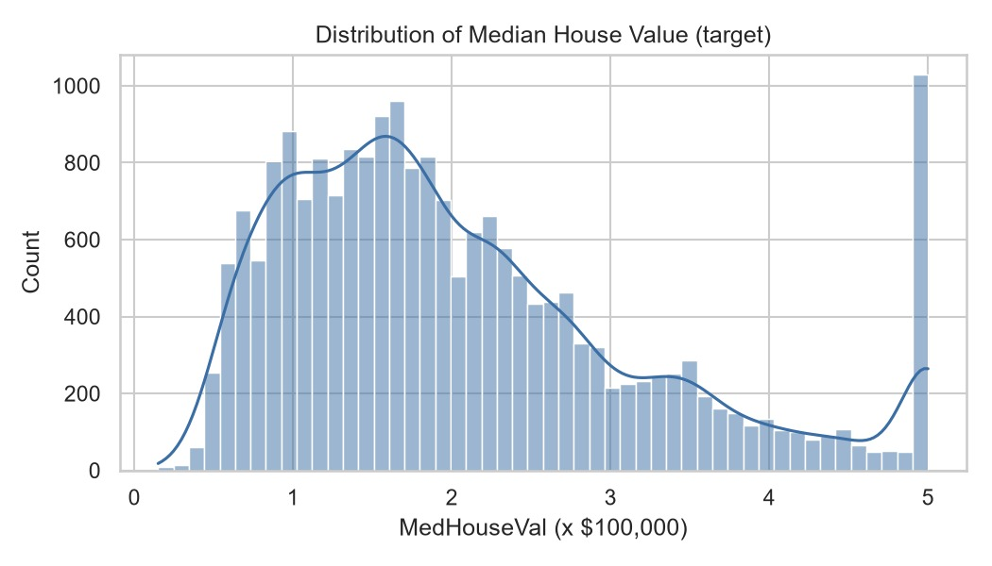
TARGET DISTRIBUTION

Slide 12
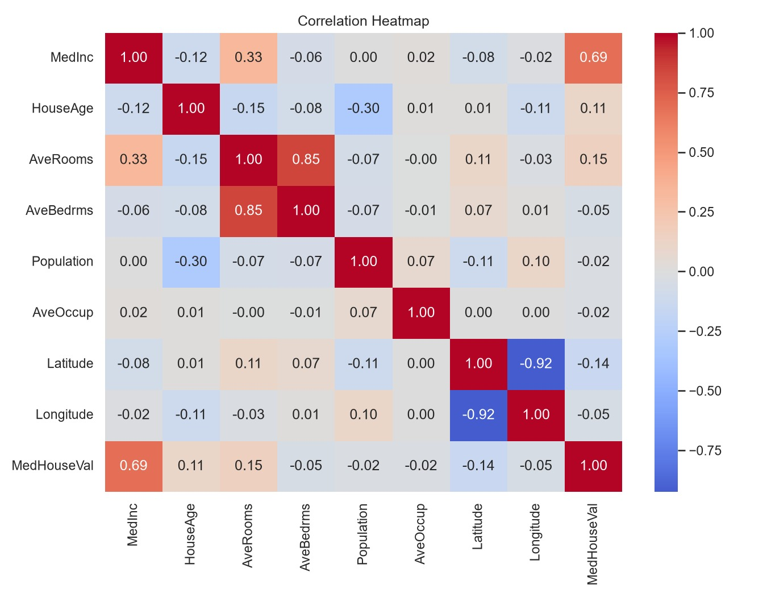
CORRELATION HEATMAP

Slide 13
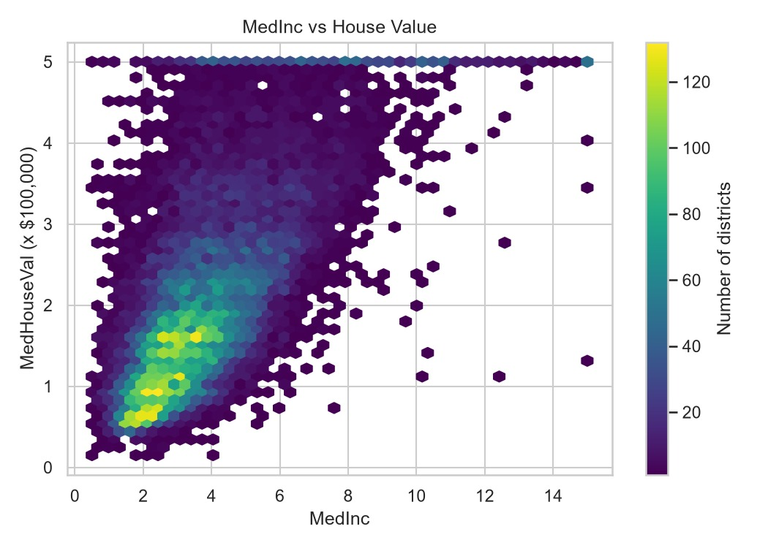
INCOME VS HOUSE VALUE

Slide 14
ALGORITHM
Machine Learning-Based House Price Prediction
Start the program.
Load the California Housing dataset.
Perform exploratory data analysis (shape, missing values, correlations).
Remove duplicates, add the BedroomRatio feature, impute missing values, and clip outliers.
Split the data into 80% training and 20% testing sets.
Scale the features using StandardScaler (for Linear Regression).
Train the Linear Regression and Random Forest Regressor models.
Evaluate both models using MAE, RMSE, and R², then select the best model and plot feature importance.
End the program.

Slide 15
WORKING
The dataset of 20,640 districts is loaded into the program.
Exploratory analysis checks the shape, missing values, duplicates, and correlations.
The data is cleaned, outliers are clipped, and the BedroomRatio feature is added.
The data is split into 80% training and 20% testing sets.
Linear Regression is trained as a baseline using scaled features.
The Random Forest Regressor is trained to capture non-linear relationships.
Both models are tested on unseen data and compared using MAE, RMSE, and R².
The best model predicts the median house value and shows which features matter most.

Slide 16
MODEL EVALUATION
Model | MAE | RMSE | R² | CV R² (mean)
Linear Regression (baseline) | 0.4808 | 0.6621 | 0.6655 | 0.6861
Random Forest Regressor | 0.3275 | 0.5052 | 0.8052 | 0.8041
Linear Regression is the baseline model, and the Random Forest Regressor is the best model.
Metrics are computed on the unseen test set (4,128 rows); CV R² is the 5-fold score on the training set.
Random Forest improves R² from 0.665 to 0.805 and reduces MAE from 0.481 to 0.328.

Slide 17
MODEL PERFORMANCE
The Model Performance section presents the evaluation of the Random Forest Regressor on the unseen test set.
R² Score: 0.805, so the model explains about 80.5% of the variance in house values.
MAE: 0.328, an average error of about $32,750.
RMSE: 0.505, which is about $50,520.
Feature Importance: MedInc (0.53), AveOccup (0.14), and Longitude (0.09) are the most important features.
Comparison: Random Forest (R² 0.805) outperforms Linear Regression (R² 0.665), so non-linear relationships matter.

Slide 18
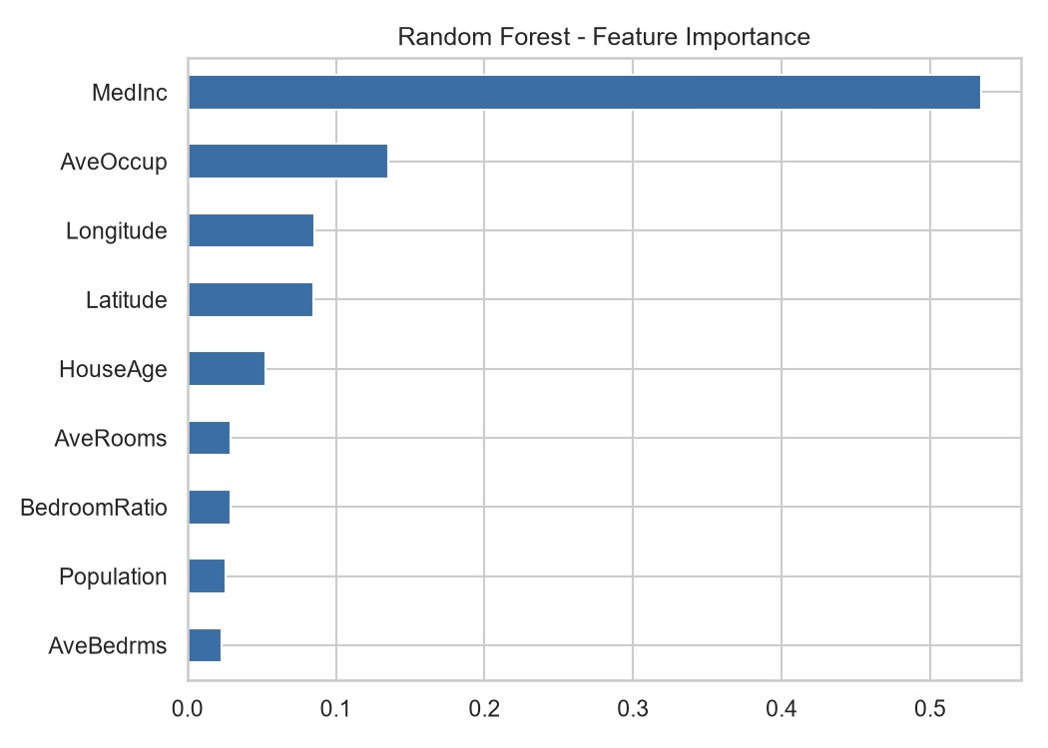
FEATURE IMPORTANCE

Slide 19
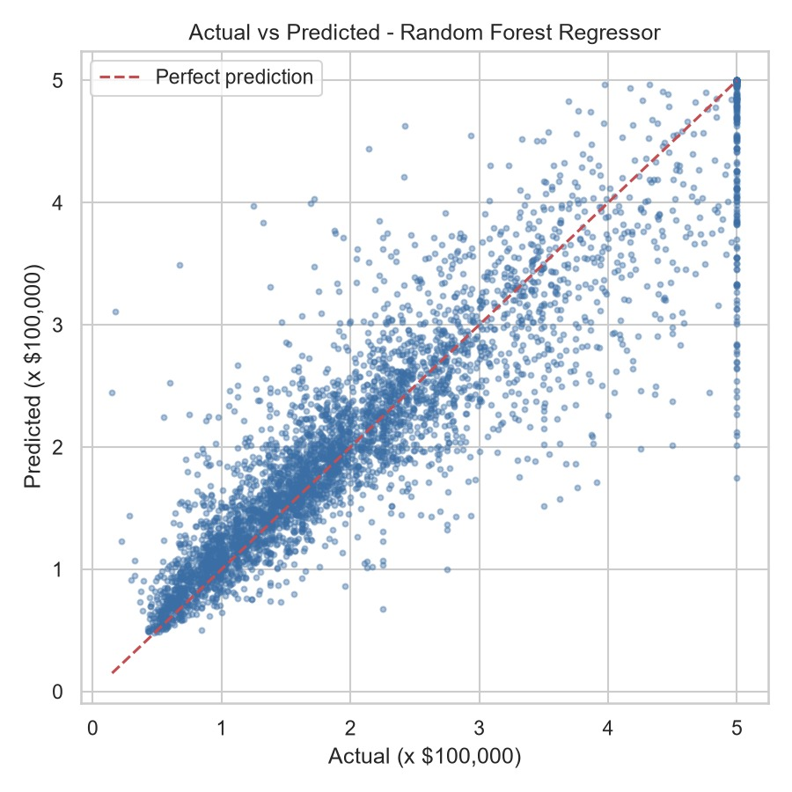
ACTUAL VS PREDICTED

Slide 20
LIMITATIONS
The data are from the 1990 US Census, so prices may not reflect today's housing market.
The target value is capped at its maximum (5.0), which affects about 4.7% of districts.
Predictions are district-level medians, not prices of individual houses.
The dataset has no information about house condition, size, or amenities.
Feature importance describes model behaviour and does not imply causation.
The model should be tuned and tested on newer data before being used for real-world pricing.

Slide 21
CONCLUSION
The House Price Prediction system uses machine learning to estimate the median house value of California districts from census features. After exploratory analysis and preprocessing, a Linear Regression baseline and a Random Forest Regressor were compared on unseen data. The Random Forest performed best, with R² = 0.805, MAE = 0.328 (about $32,750), and RMSE = 0.505 (about $50,520), explaining about 80.5% of the variance in house values. Median income was the most important feature (0.53), followed by average occupancy and longitude. Compared with the linear baseline (R² = 0.665), this shows how much non-linear relationships matter. Future work includes hyperparameter tuning (GridSearchCV), gradient boosting, and location-based features.

Slide 22
REFERENCES
Pace, R. K. and Barry, R. (1997). Sparse Spatial Autoregressions. Statistics & Probability Letters, 33, 291-297.
scikit-learn documentation for fetch_california_housing - https://scikit-learn.org/stable/modules/generated/sklearn.datasets.fetch_california_housing.html
scikit-learn documentation for Linear Regression and Random Forest Regressor.
pandas and NumPy documentation for data handling and analysis.
Matplotlib and Seaborn documentation for data visualization.
Project source code: house_price_prediction.py and results_summary.txt.

Slide 23
THANK YOU…

